Slide 1
Buellton Union School District
District Plan for hybrid reopening - 2020/21
Special thanks to the Reopening Task Force of staff, parents and community members for your input to provide a safe and engaging learning environment.
LET’S COME LEARN TOGETHER ...SAFELY!

Slide 2
Key considerations
Safety of students and staff
Mental wellness
Academic needs

Slide 3
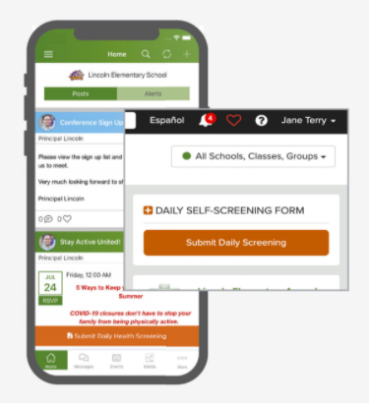
Shared Responsibility - Daily at home health screening
Complete the ParentSquare Daily Health Screening PRIOR TO bringing student to school.
Please do not bring your child to school if they are not feeling well.
Should your child become ill while at school, we count on you to arrange for the immediate pick up of your child.

Slide 4
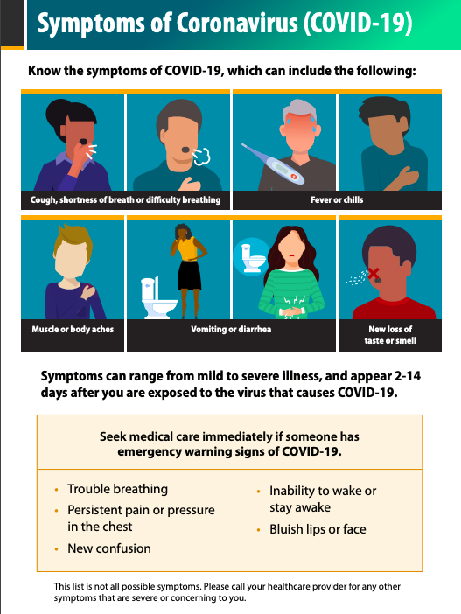
COVID-19 Symptoms
People with COVID-19 have had a wide range of symptoms reported – ranging from mild symptoms to severe illness. Symptoms may appear 2-14 days after exposure to the virus. People with these symptoms may have COVID-19:
Fever or chills
Cough
Shortness of breath or difficulty breathing
Fatigue
Muscle or body aches
Headache
New loss of taste or smell
Sore throat
Congestion or runny nose
Nausea or vomiting
Diarrhea
- CDC.gov

Slide 5
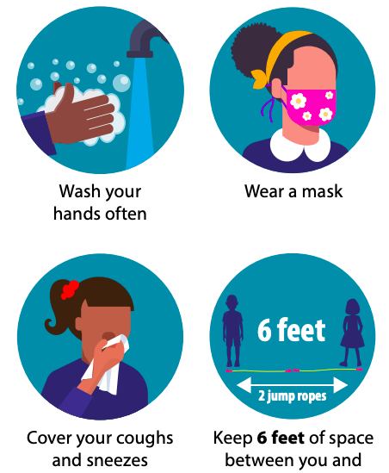
Center for Disease Control (CDC) safety protocols
Resources:
CDC Wash Your Hands video
CDC - Stop the Spread video

Slide 6
Safety practices at school
Masks worn by all
Frequent hand-washing
6 feet of physical distancing maintained inside / outside
Staggered arrival / departure
Staggered recess with zoned playground locations
Sick room (isolation room) for students waiting to be picked up
Health Aide at both sites
No shared materials
Students bring device to and from school.
Additional cleaning / disinfection
Plexiglass shields on desks
Stable groups = classroom cohorts
Additional hand washing stations
Hand sanitizer available in every classroom
Restrooms assigned to grade levels

Slide 7
Classroom Video
Click Here

Slide 8
Potential Hybrid learning schedule and choices
Cohort A (½ of in-person class)
In-person learning Monday / Thursday
Independent work Tues/Weds/Fri with daily 30 minute whole class check in
Cohort B (other ½ of in-person class)
In-person learning Tuesday / Friday
Independent work Mon/Weds/Thurs with daily 30 minute whole class check in
*Distance Learning Option available for students who are not ready to return to in-person learning. *Will look very different than current Virtual Academy.
NOTE: Classroom teachers will teach 4 days a week.
In person Learning Groups: receive 2 full days of in-person instruction and 3 independent work days with 30 minute whole class check-in.
Distance Learning students will have daily 30 min. whole class check-in and independent work throughout the day.
Schedule: January start-up
Parents receive cohort information prior to winter break.

Slide 9
BUSD FAMILY SURVEY
open 11/13 - 11/16
Link:
https://www.surveymonkey.com/r/7LWC3Z7

Slide 10
Resources
CA Dept of Public Health - COVID-19 Guidance for Schools - August 3, 2020
Center for Disease Control (CDC) - Operating Schools During COVID-19: CDC’s Considerations

